Slide 1
AI: Last Thoughts
COMP 4230
David J Stucki
Fall 2024

Slide 2
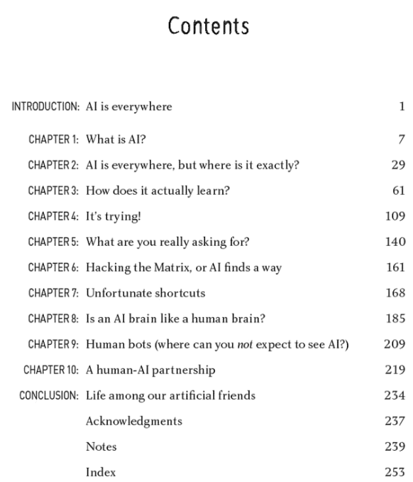
AI Weirdness
Published in 2019
An interesting read after Larson
Written for a non-technical, general audience
However, does a great job of explaining how neural nets and evolutionary computation work
Also explores many of its weaknesses, pitfalls, and weirdnesseseseseseses

Slide 3
It's Trying!
“Let's focus som more on [AI] doom—cases in which an AI-powered solution is a terrible way of solving a real-world problem. These cases can range from slightly annoying to quite serious. ... These could be instances when we
gave it a problem that was too broad,
didn't give it enough data for it to figure out what's going on,
accidentally gave it data that confused it or wasted time,
trained it for a task that was much simpler than the one it encountered in the real world,
or trained it in a situation that didn't represent the real world.”
—Shane, p. 109 (You Look Like a Thing and I Love You) —
What is the lesson here?

Slide 4
What are you really asking for?
The fitness function that is used to measure how well an AI is doing probably doesn't measure what you think it does.
Examples (pp. 140-141)
Every AI is trained in a simulated environment, which may not match reality.
Examples (p. 143)
Hacking Reward Functions
people do this all the time ☺
Why walk when you can fall?
Why jump when you can cancan?
Why drive when you can spin?
When in doubt, do nothing

Slide 5
Is an AI brain like a human brain?
Adversarial Attacks
Examples (pp. 198-201)
Missing the obvious
Examples (pp. 206-207)
Human bots
Amazon Mechanical Turk?
Chat-bot customer service agents?
AI start-ups before their AI is ready...?

Slide 6
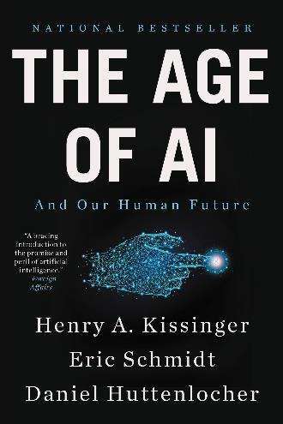
The Futurists and the AI Industry...
Ray Kurzweil
Eric Schmidt
ISO 42001
AI Management Systems international certification & audit specification

